Slide 1
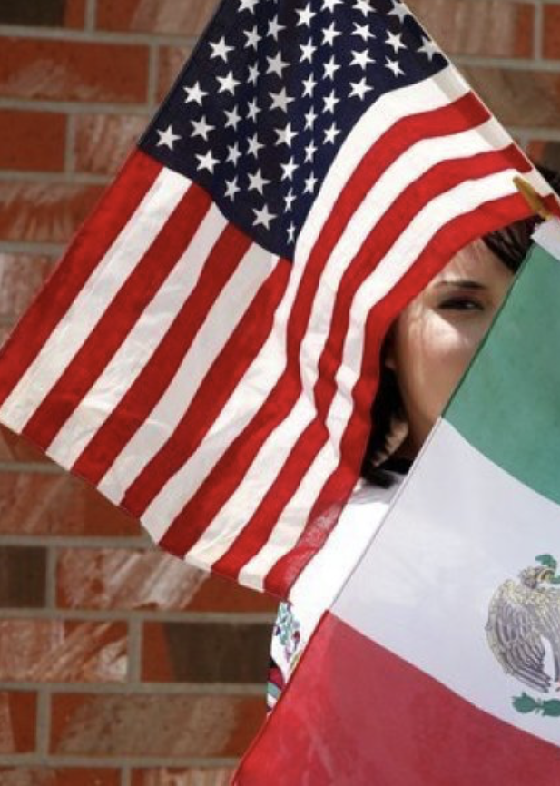
Give Me Your Poor, Your Tired, Your Homeless (Some Restrictions
May Apply):
Immigration to the United States in the 21st Century
Bob Gitter, Ohio Wesleyan
Prof of Econ, Emeritus
National Economic Education Delegation
WVU OLLI
October 27, 2023

Slide 2
SubSSSubmitting Questions
Please submit questions in the chat.
  I will try to handle them as they come up, but may take them in a bunch as time permits. I will let Jascenna
We will do a verbal Q&A once the material has been presented.
  And the questions in the chat have been addressed.
OLLI allowing, we can stay beyond the end of class to have further discussion.

Slide 3
Course Outline
Contemporary Economic Policy
  Week 1 (10/6): Economic Update (Geoffrey Woglom, Amherst College)
  Week 2 (10/13): Trade and Globalization (Avik Chakrabarti, U of Wisconsin Milwaukee)
  Week 3 (10/27): Economics of Immigration (Robert Gitter, Ohio Wesleyan)
  Week 4 (11/3): Monetary Policy (Geoffrey Woglom ,Amherst College)
  Week 5 (11/10): Federal Debt (Joseph Carolan, Oakland University)
  Week 6 (11/17): International Institutions (Alan Deardorff University of Michigan)
Questions at end.

Slide 4
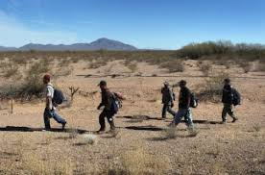
Migration to the US
Difficult to Measure How Many
Legal Immigrants - easy
Undocumented Immigrants
Return Immigrants – no record if return

Slide 5
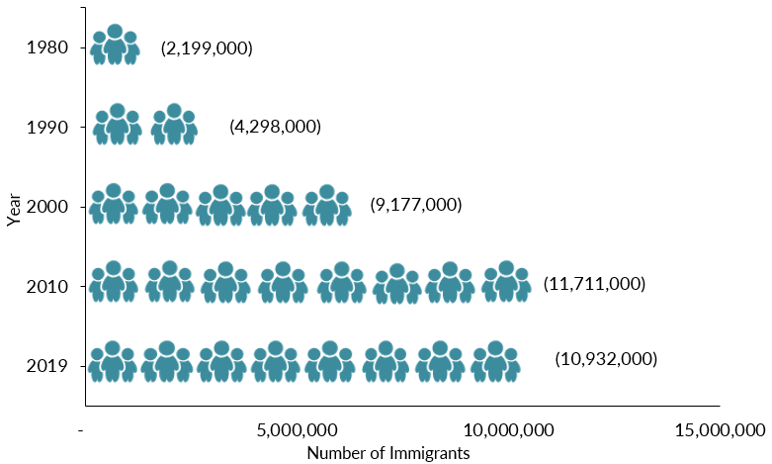
Mexican-Born People in the US
1 in 14 people born in Mexico currently lives in the US

Slide 6
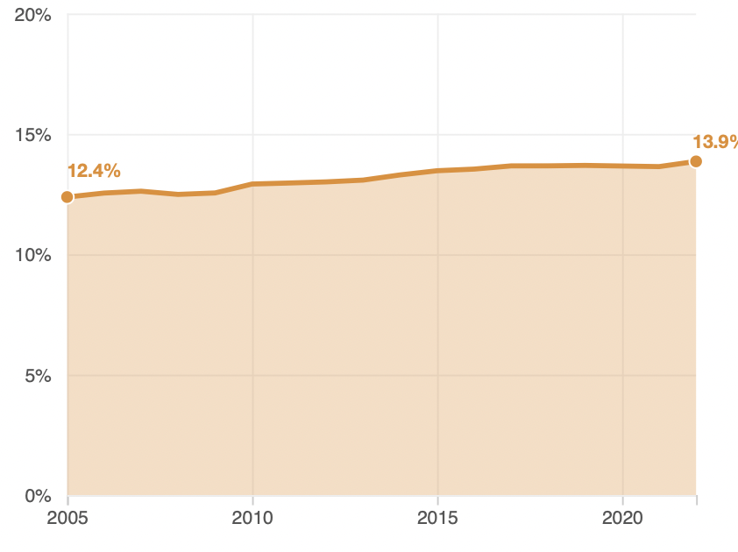
Immigrant Share of US Population

Slide 7
Immigrant Share of US Population
West Virginia < 2 %

Slide 8
The Migration Decision
Benefit of Migrating
Benefit of Staying
Cost of Migrating

Slide 9



Distribution of Income

Slide 10
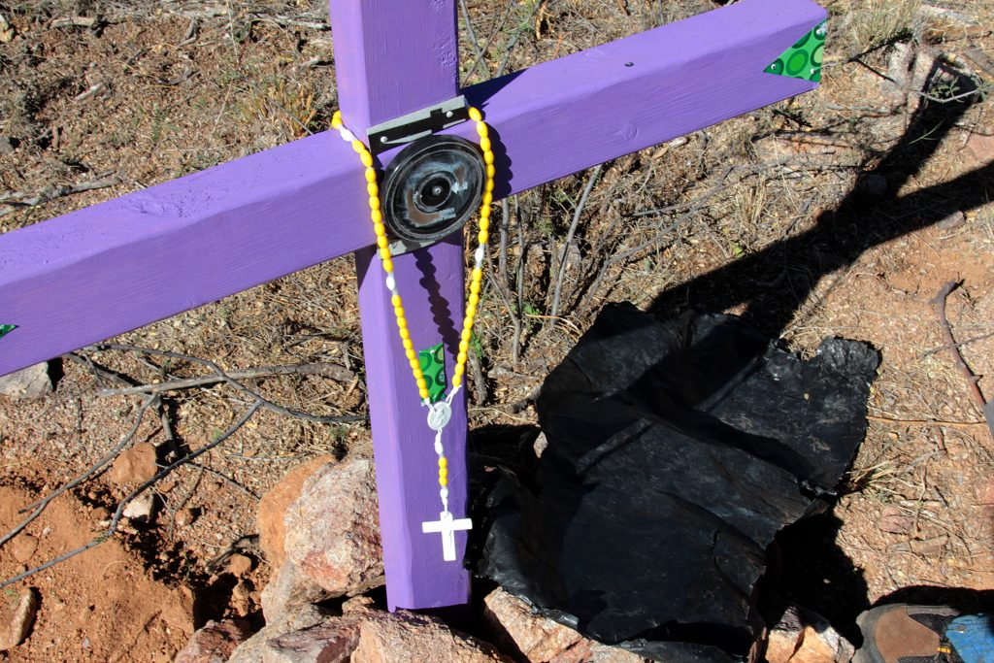
The Dangers of Border Crossing

Slide 11
Key Laws
Quota and Immigrations Acts (1921 and 1924)
Bracero Program(1942-1964)
Immigration and Nationality Act (1965)
Immigration and Control Act (1986)

Slide 12
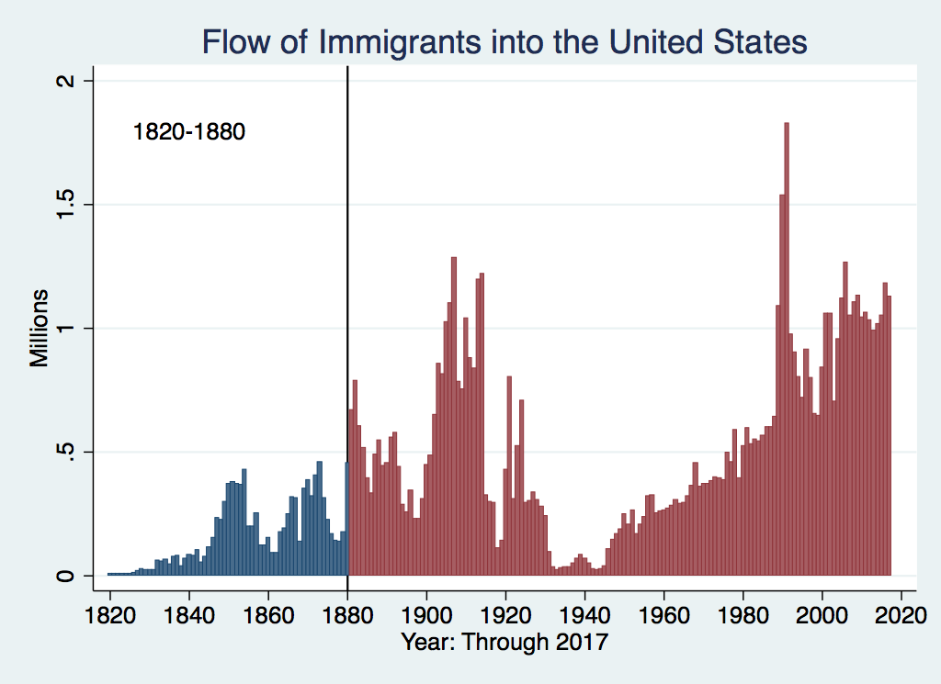
U.S. Immigration 1820-1880
Source Country | 1820-1880
Germany | 3,000,000
Ireland | 2,800,000
Britain | 2,000,000
Austro-Hungarian Empire | 1,000,000
Canada | 750,000
China | 230,000
Africa | 50,000
https://www.libertyellisfoundation.org/immigration-timeline

Slide 13
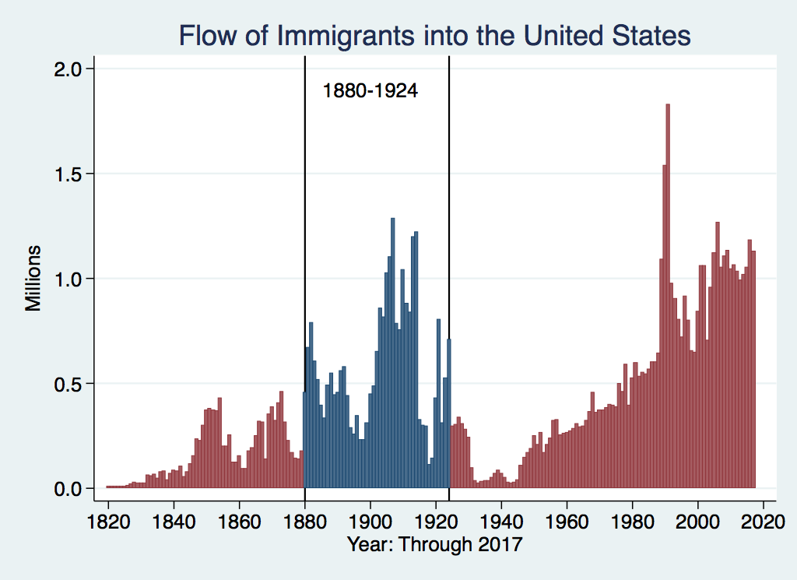
U.S. Immigration 1880-1924
Source Country | 1880-1930
Italy | 4,600,000
Austro-Hungarian Empire | 4,000,000
Russian Empire | 3,300,000
German Empire | 2,800,000
Britain | 2,300,000
Canada | 2,300,000
Ireland | 1,700,000

Slide 14
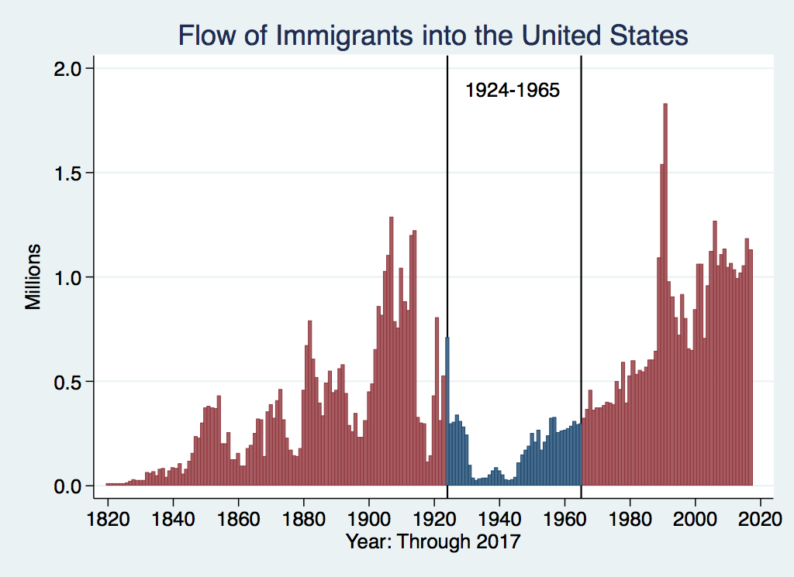
U.S. Immigration 1924-1965
Source Country | 1930-1965
Germany | 940,000
Canada | 900,000
Mexico | 610,000
Britain | 480,000
Italy | 390,000
Caribbean/ West Indies | 310,000
https://www.libertyellisfoundation.org/immigration-timeline

Slide 15
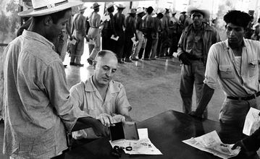
Signing up for Bracero Program

Slide 16
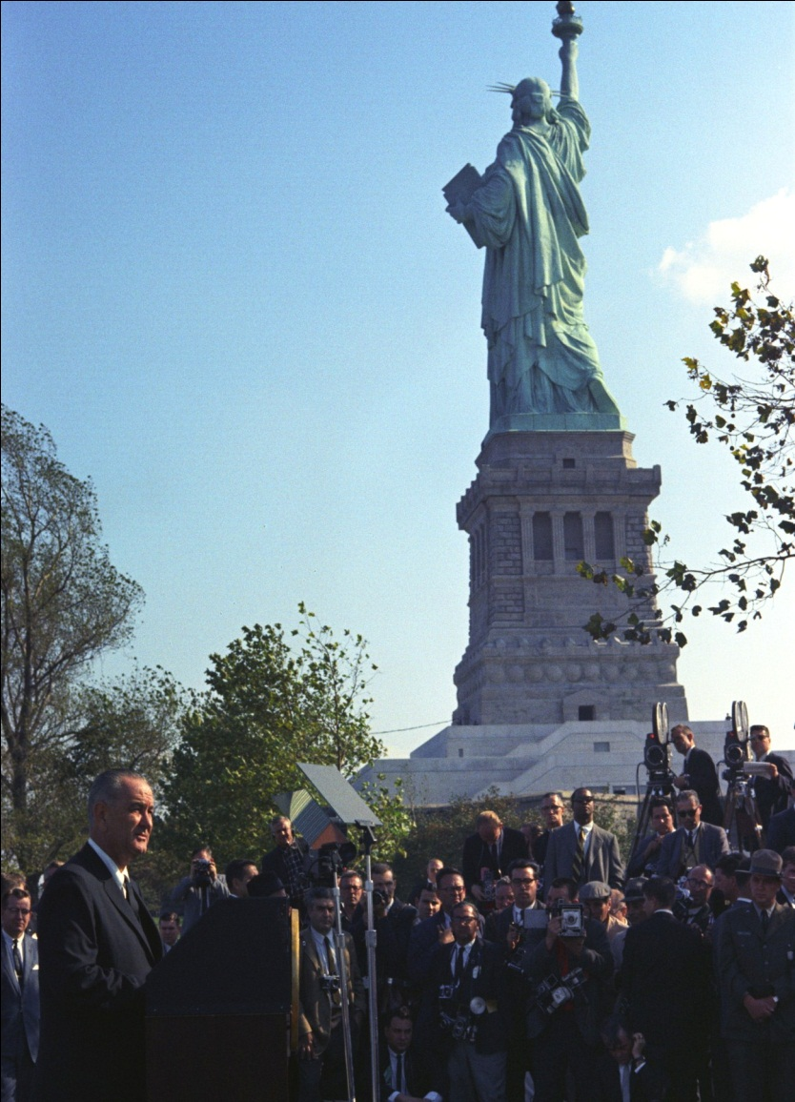
LBJ Signs Immigration and Nationality Act (1965)
Abolished Quotas
Limits immigration to about 1 million/year
Family reunification most important consideration

Slide 17
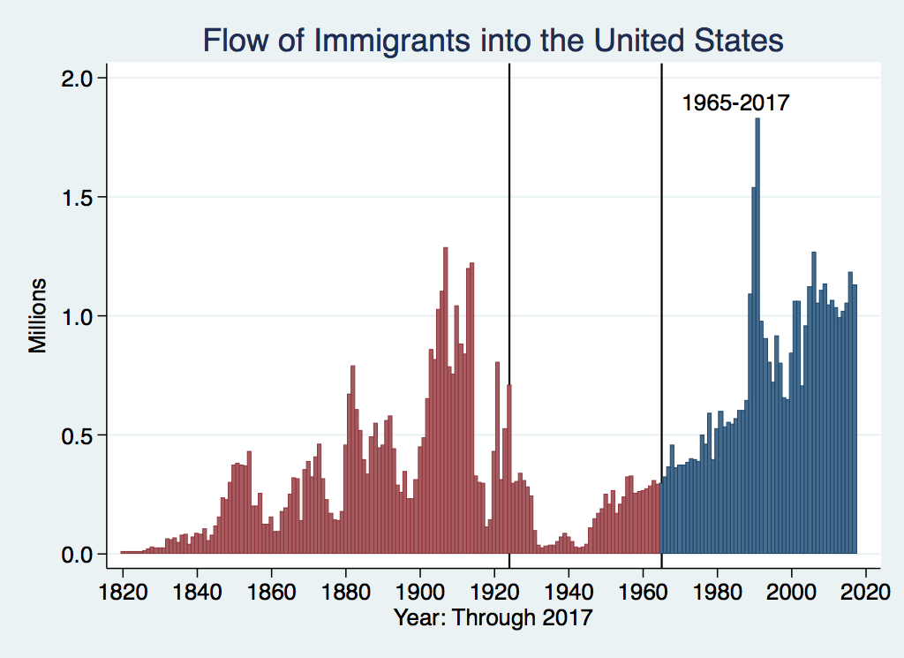
History of U.S. Immigration: 1965-Today
Source Country | 1965-2017
Mexico | 4,300,000
Philippines | 1,400,000
Korea | 760,000
Dominican Republic | 750,000
India | 740,000
Cuba | 700,000
Vietnam | 700,000
Canada | 650,000
https://www.libertyellisfoundation.org/immigration-timeline

Slide 18
NUMBER OF IMMIGRANTS BY TYPE OF ADMISSION: FISCAL YEAR 2022
Family-sponsored preferences | 165,642
Immediate relatives of U.S. citizens | 428,581
Employment-based preferences³ | 270,206
Diversity | 43,175
Refugees | 29,407
Asylees | 53,662
Other | 27,331
TOTAL | 1,018,004
{
594,223

Slide 19
H1B Applications
Quota Reached on First Day 2017

Slide 20
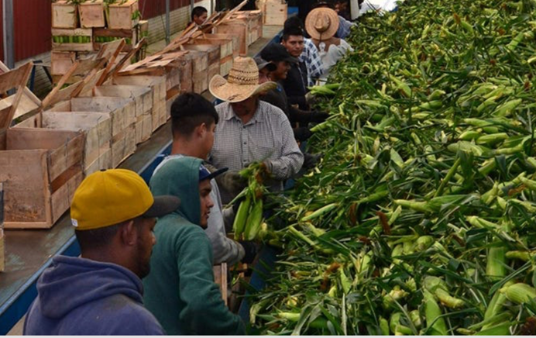
H2A Program

Slide 21
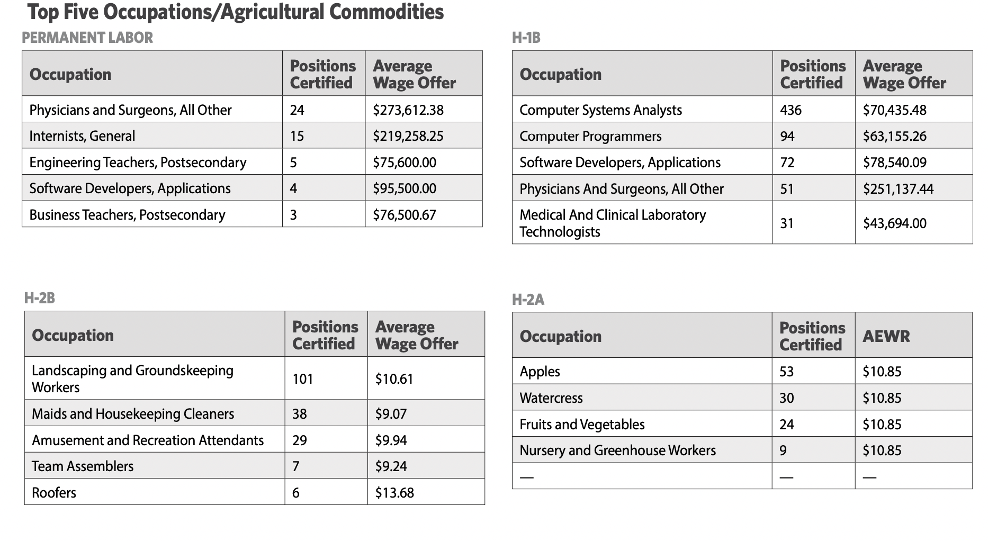
Employment Immigration to West Virginia - 2022

Slide 22
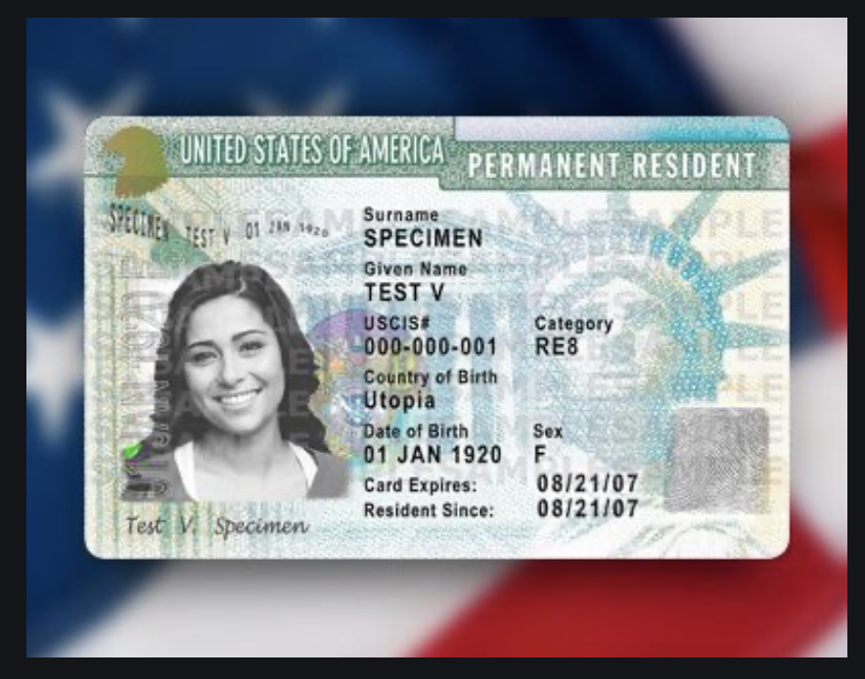
Immigration Reform and Control
Act of 1986
Grants amnesty to undocumented individuals in US since 1982
Must pay penalty and back taxes
Amnesty granted for being undocumented
Path to citizenship
Two million people took advantage, mostly Mexican
Illegal to knowingly hire undocumented workers
Green Card

Slide 23
Immigrant Share of US Workforce
2022 18.1 % immigrant share

Slide 24
Origin of Immigrants
Home | U.S. Share | WV Share
Europe | 9.1 % | 23.1 %
Asia | 39.3 % | 43.2 %
Africa | 9.4 % | 7.9 %
Oceana | 0.6 % | 0.7 %
N. America | 32.7 % | 20.5 %
S. America | 8.2 % | 4.7 %
Unknown | 0.6 % | --
Total | 100.0 % | 100.0 %

Slide 25
The Migration Decision
Benefit of Migrating
Benefit of Staying
Cost of Migrating

Slide 26
Characteristics of Native and Latin Amer. Born Population (Age 16 & up)
 | Native Born | Lat. Amer. Born
Labor Force | 130 Mil. | 13 Mil
< H.S. Educ | 5.8% | 37.1.%
Poor English | 1.9% | 77%
Employed | 59.2% | 64.9%
Unemployed | 3.0% | 3.5%
Med. Wk. Earn | $1,087 | $758
Poverty Rate | 13% | 17%

Slide 27
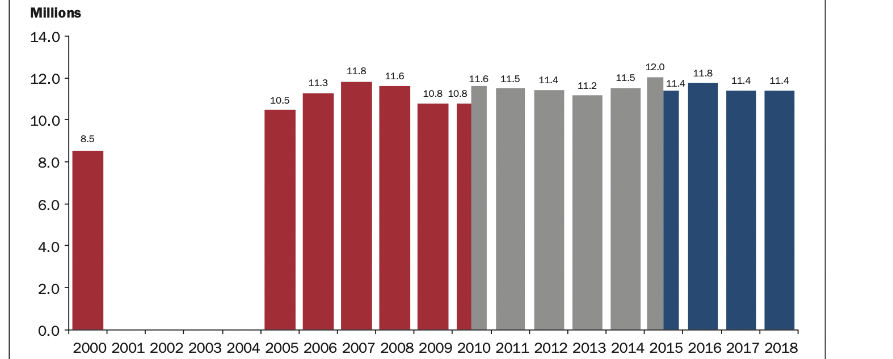
Number of Undocumented Immigrants in the United States
Source: U.S. Department of Homeland Security

Slide 28
Impact of Mexican Immigration
Low-skill, low-wage jobs.
Competition for less skilled native-born
More GDP & lower prices
Helps upper income native-born, hurts lower
Little impact on federal budget but raises costs for state and local (schooling)

Slide 29
DACA (Deferred Action for
Childhood Arrivals)
Entered U.S. before age 16, now in U.S.
Entered before June 2007
Currently in school, high school grad or honorable discharge from military
No felony conviction or threat to security
Renewable every 2 years
Executive Order by Obama, Trump ended, Biden restored in January

Slide 30
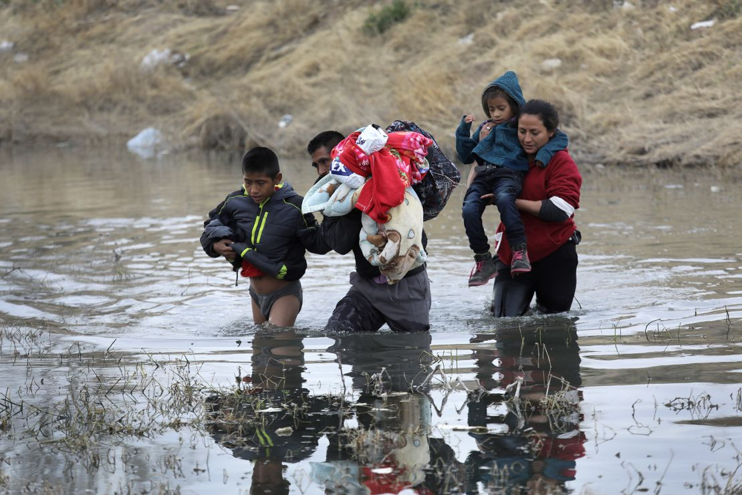
Recent Immigration Issues
The Northern Triangle
Unaccompanied Minors
Covid and Title 42
The Venezuelan Wave

Slide 31
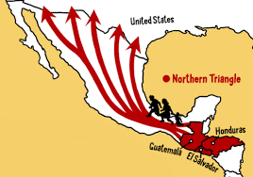
The Northern Triangle

Slide 32
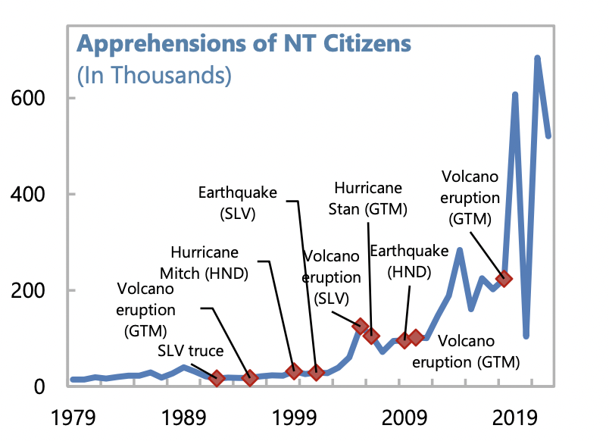
US Border Apprehensions from the Northern Triangle

Slide 33
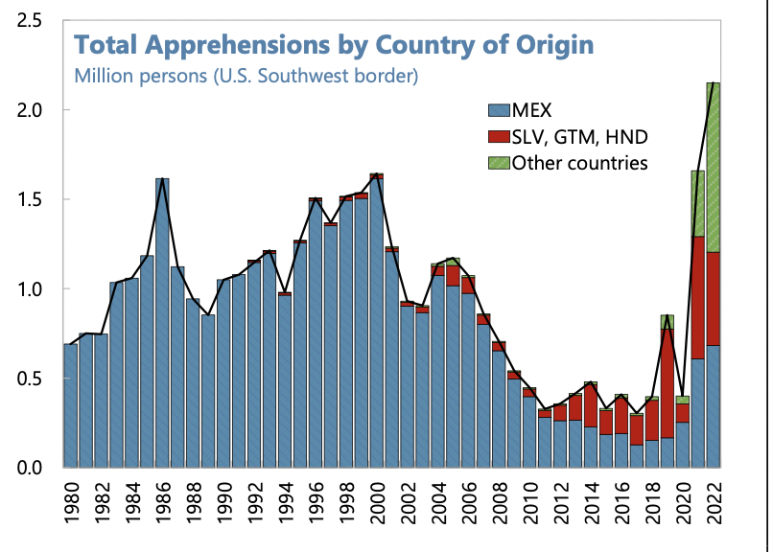
Northern Triangle Apprehensions
(Northern Triangle Countries in Red)

Slide 34
Asylees and Refugees
Refugees are usually outside the United States when they are screened for resettlement in US
Asylum seekers submit their applications while physically present in the United States or at a U.S. port of entry
Reason to grant – (US & UNCOR) unable to return because of persecution or a well-founded fear of persecution based on: race, religion, nationality, membership in a particular social group, or political opinion. (Not economic hardship!)

Slide 35
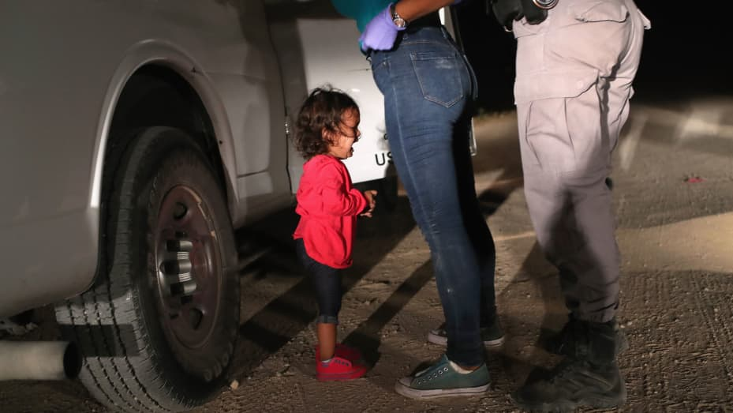
Separation of Children

Slide 36
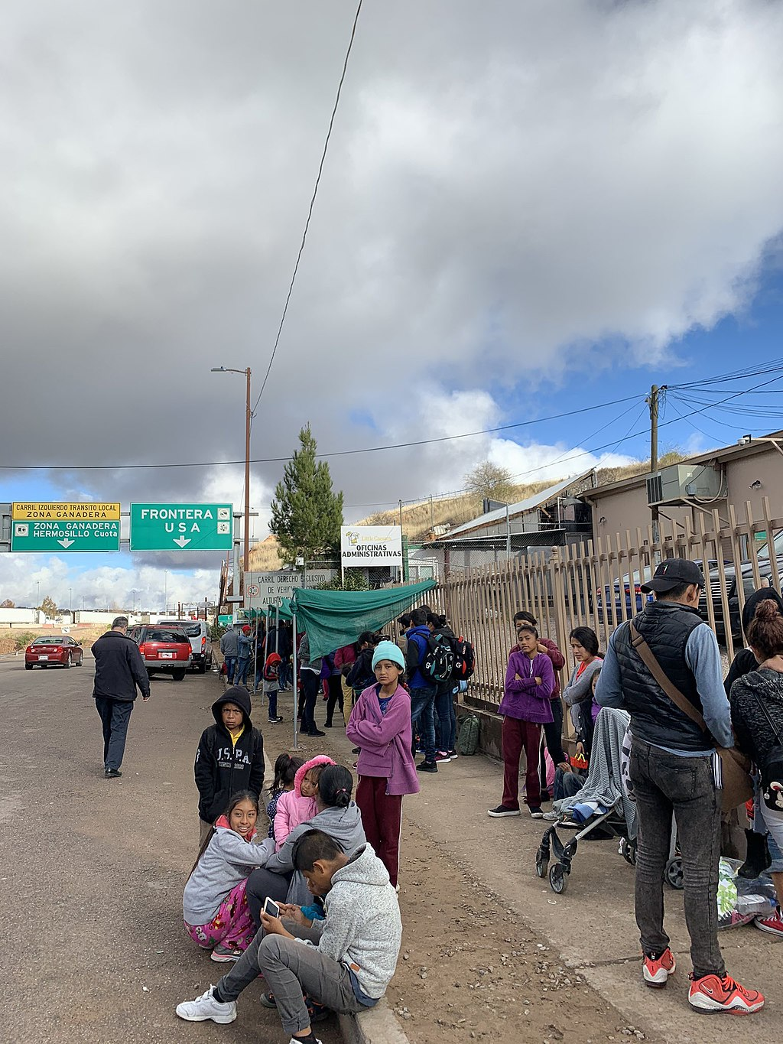
Remain in Mexico Policy
Applies to non-Mexicans asking for asylum
Must wait in Mexico while case being heard
Not applied to unaccompanied minors
Not eligible for asylum if passed through another nation on way.
Dangerous in Mexico
In the courts now

Slide 37
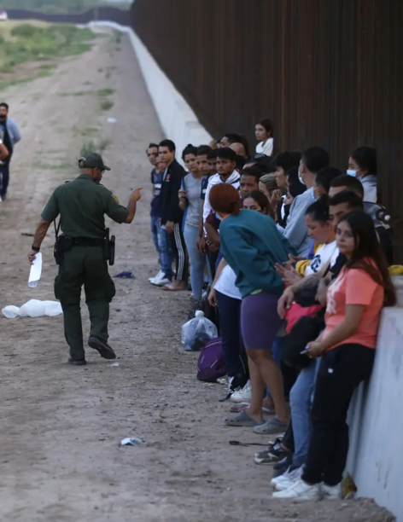
Covid and Title 42
Started in March 2020.
Used to limit Covid
Migrants who crossed into United States not allowed to ask for asylum
Returned to Mexico, not allowed a hearing
Ended May 2023

Slide 38
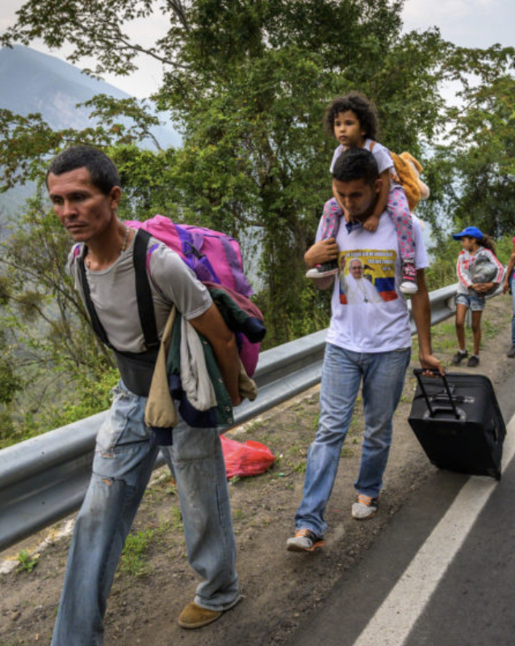
The Surge of Venezuelans
Almost 8 million Venezuelans have left
Caused by economic mismanagement, hyperinflation, unrest, violence
Largest national group arrested for entering US
Temporary Protected Status

Slide 39
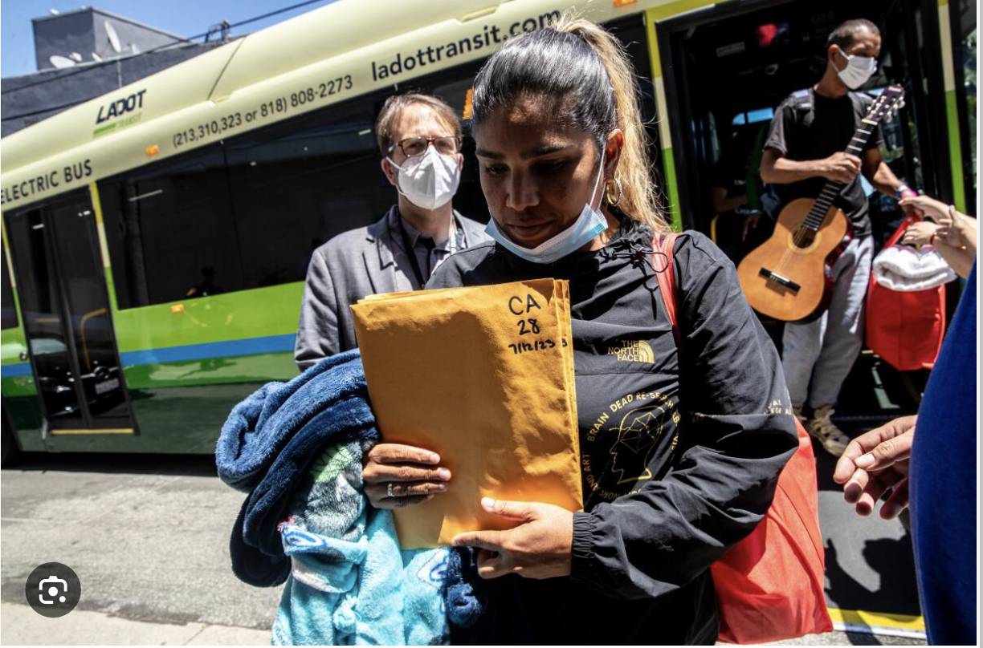
The Bussing of Migrants

Slide 40


Slide 41

Thank You
Any Questions?
Bob Gitter
Professor of Economics, Emeritus
Ohio Wesleyan University

